Slide 1



OPPORTUNITY REVIEW
DIRECT-TO-EMPLOYER GTM STRATEGY
Exploring a Kettering Health Network DTE Plan

Slide 2


Founded in 1979, headquartered in Indianapolis
Largest Independently-Owned Full-Service Third-Party Administrator
Specialize in Administration of Self-Funded Plans and Population Health Management​
Leader in the Direct-to-Employer Movement
We Know and Understand the Market
Experience Working with All Professional Teams: Agents, Networks, MGAs
The Key Family of Companies is a Vertically Integrated group of benefit related organizations
3,000+ Corporate Clients
3 Million Members under Management
700 Employees

Slide 3


MARKET LEADER
IN
PRIVATE LABELED
DTE PLANS
Louisville, KY
OneHealth Plan
Cincinnati, OH
TCH Optimal
Bentonville, AR
Northwest Health Plan
Knoxville, TN
East Tennessee Health Plan
Meridian, MS
Affinity Health Plan
Fort Myers, FL
Lee Health Care Partners

Slide 4
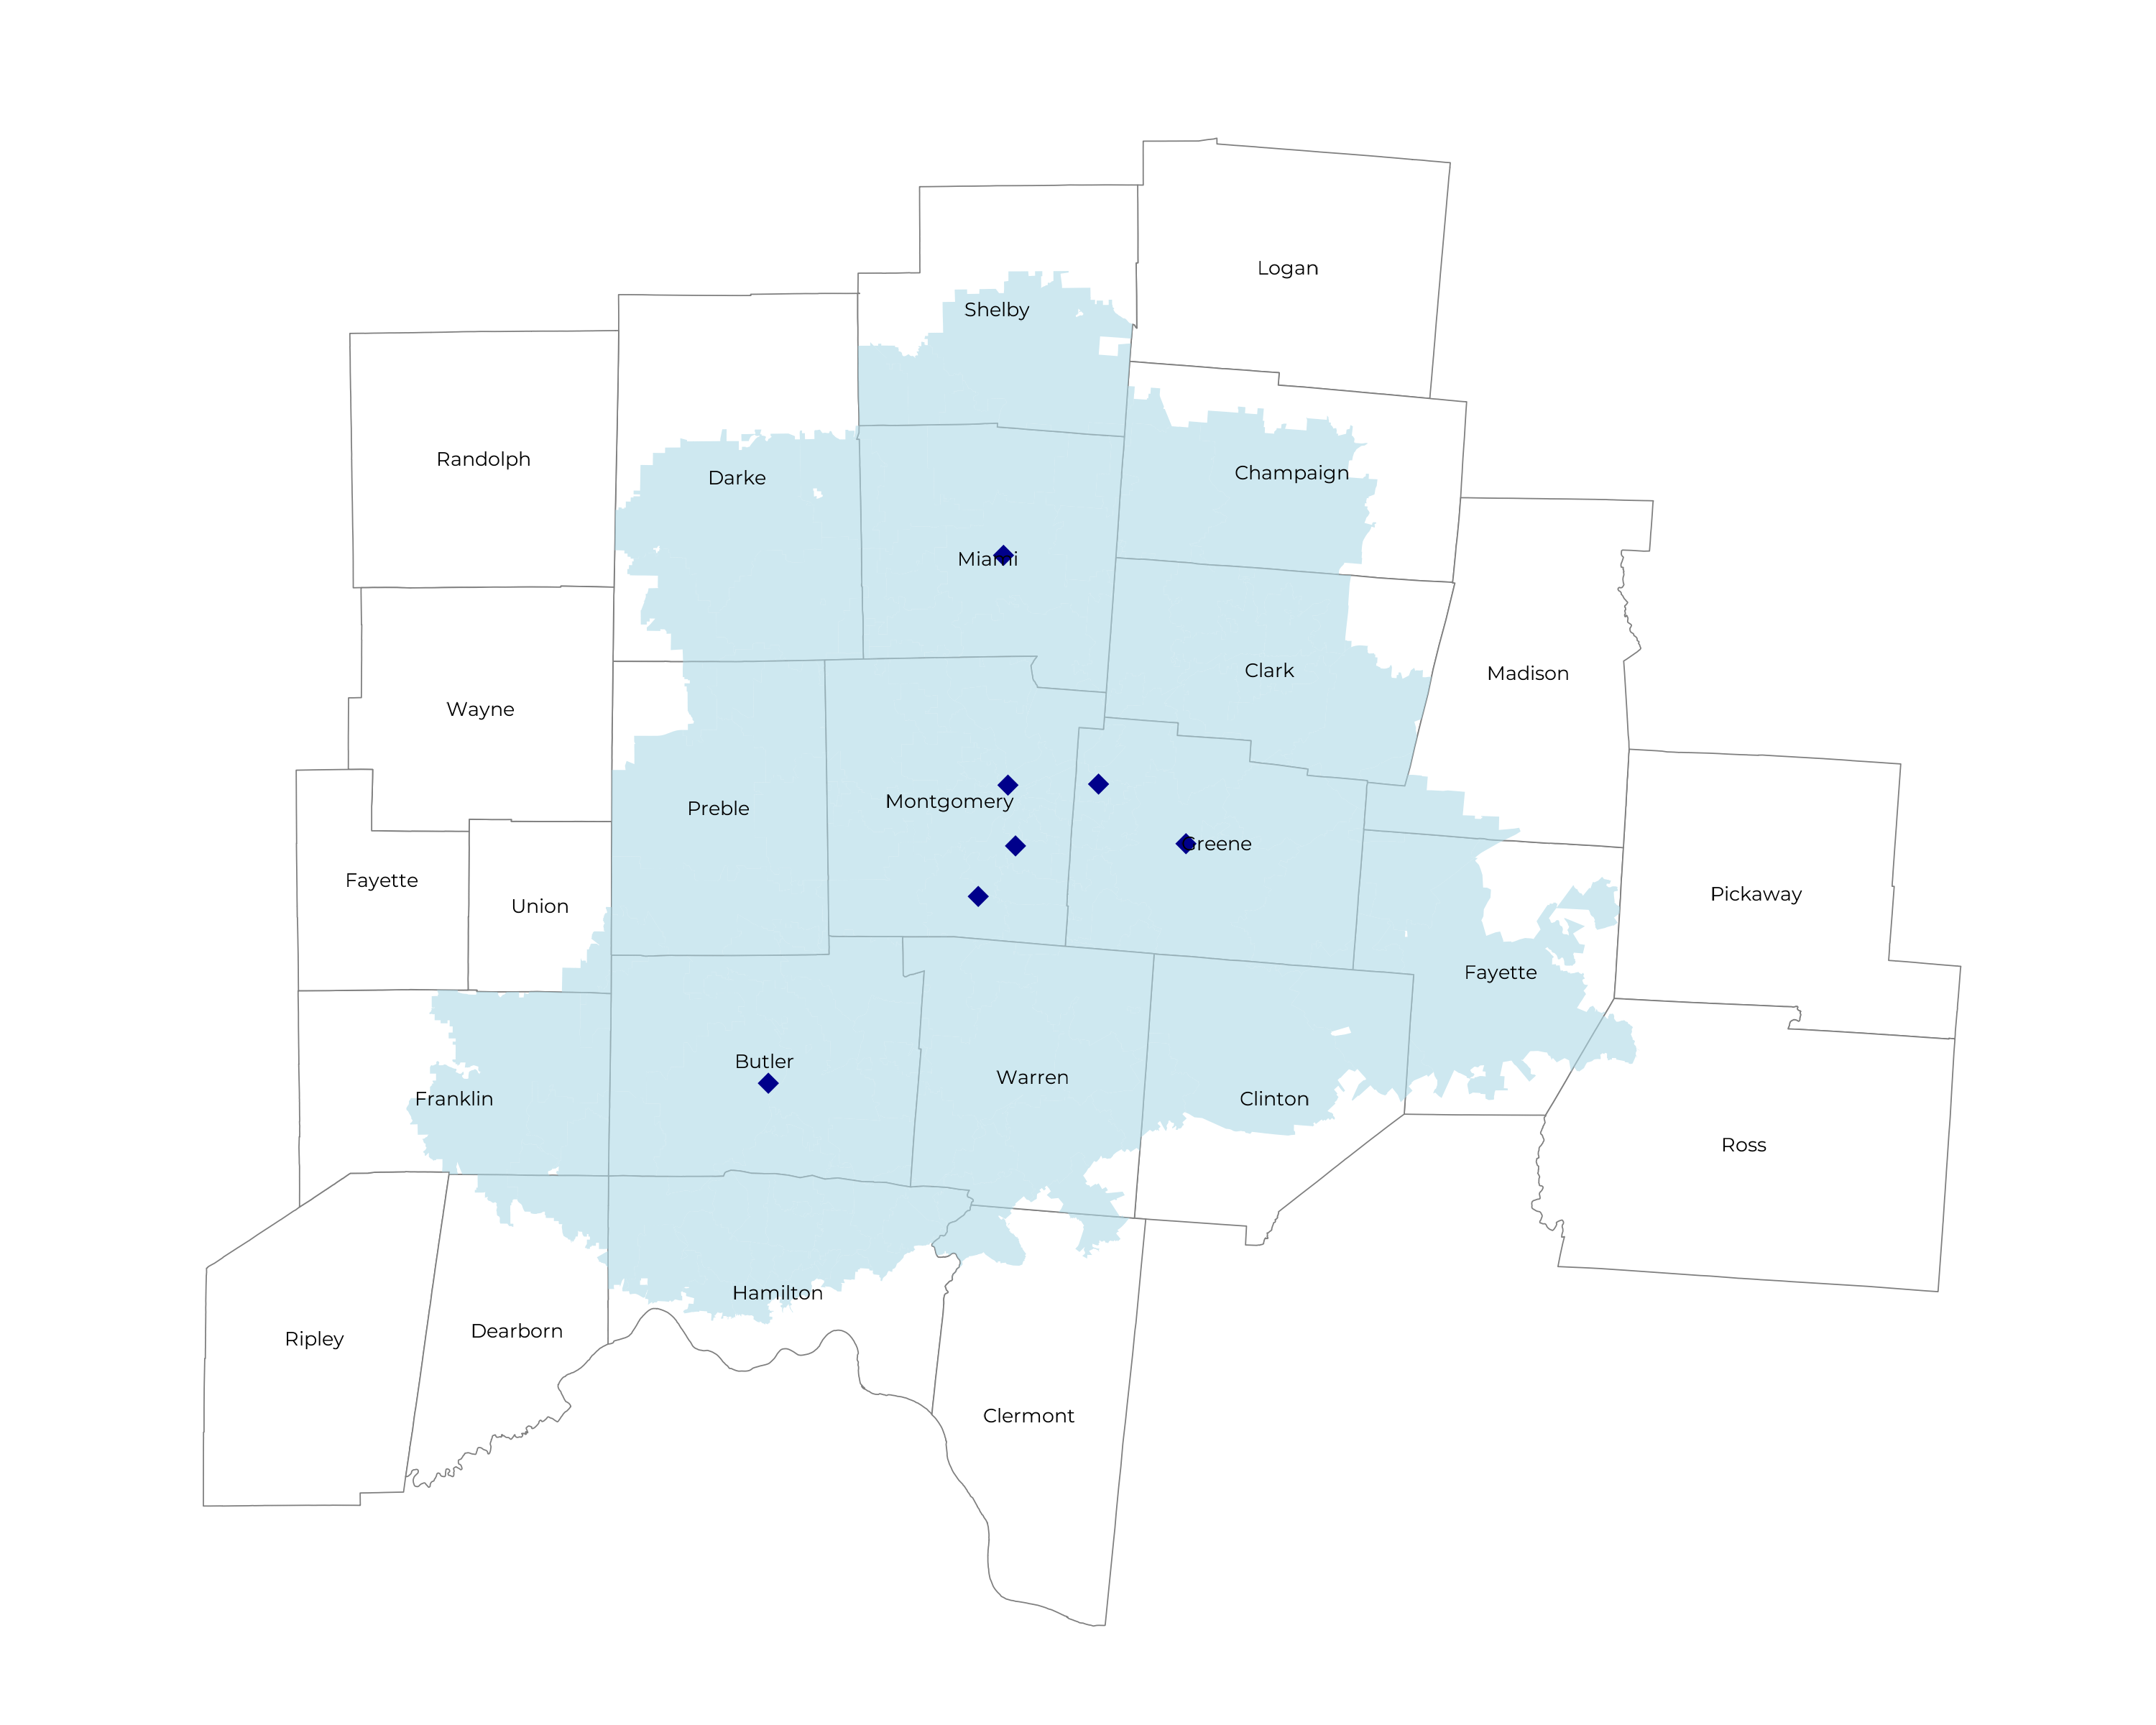
SIGNIFICANT OPPORTUNITY FOR PLAN GROWTH Researched for the below highlighted service area
Target Market 2,800+ Employers 600,000+ Employees 1,000,000+ Members
 | Employer Size Group (# of Employees)
Commercial Employers With Headquarters | 50-100 | 101-200 | 201-400 | 401-1,000 | 1,001-3,000 | 3,000+
In Catchment Area | 1,407 | 669 | 407 | 250 | 72 | 50
Total Employees at Employers | 50-100 | 101-200 | 201-400 | 401-1,000 | 1,001-3,000 | 3,000+
Headquartered in Catchment Area | 105,500 | 100,400 | 122,100 | 175,000 | 144,000 | 300,000
Total Members with Employers | 50-100 | 101-200 | 201-400 | 401-1,000 | 1,001-3,000 | 3,000+
Headquartered in Catchment Area | 189,900 | 180,700 | 219,800 | 315,000 | 259,200 | 540,000

Slide 5
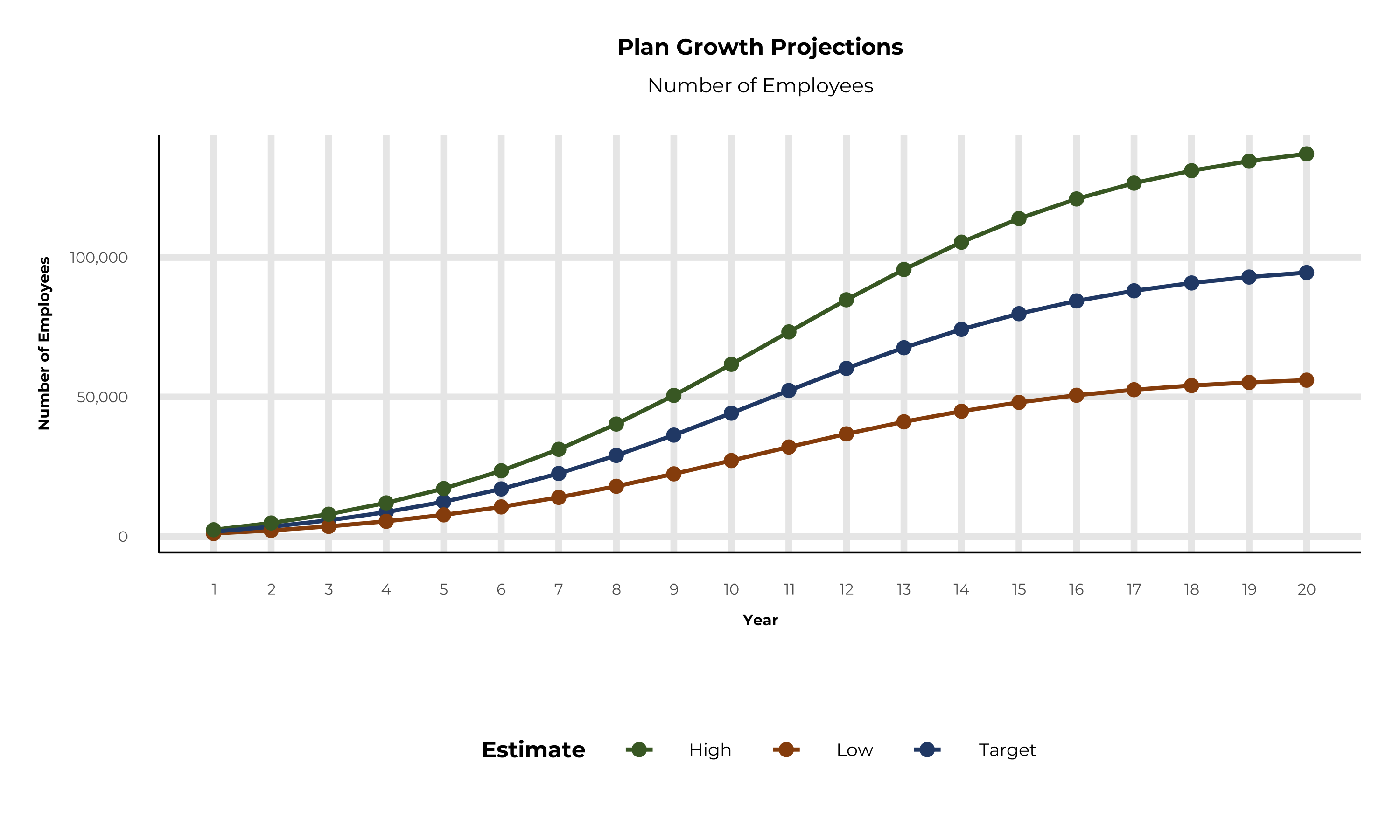
PLAN POTENTIAL GROWTH PATHS
Self Funded
648K
Insured
925K
Working Age
1,296K
Population
2,235K
Estimates includes the Kettering Health Network service area in Dearborn, Franklin, Union, Butler, Champaign, Clark, Clermont, Clinton, Darke, Fayette, Greene, Hamilton, Madison, Miami, Montgomery, Preble, Shelby, and Warren Counties

Slide 6
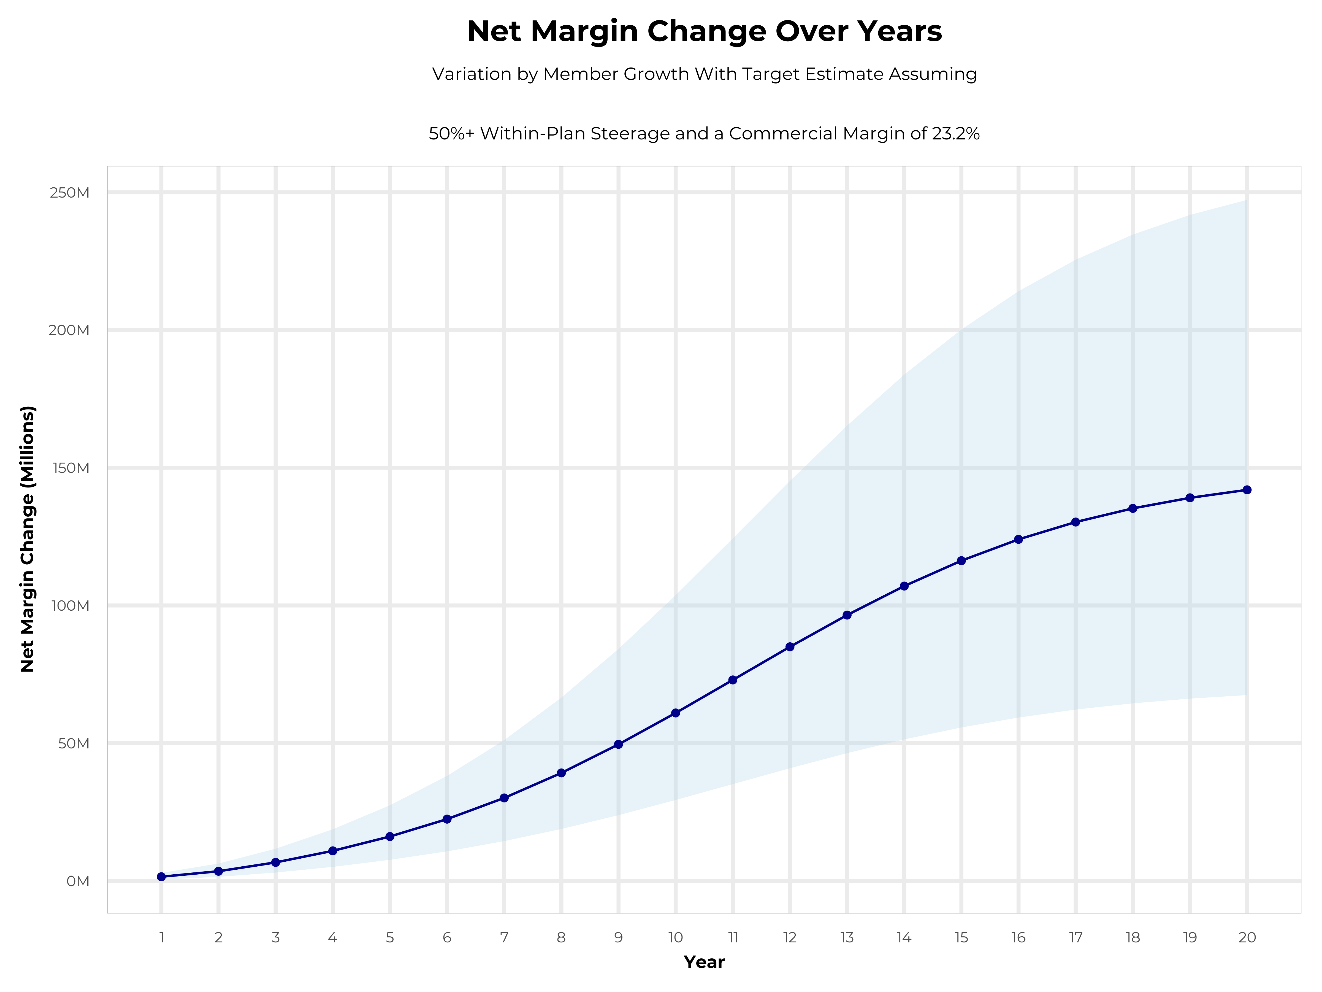
GROWING POWERFUL, LASTING PROFITABILITY
Early Stage
Gaining Name Recognition, Early Growth
New Revenue:
New Profit:
$44.01M
$10.2M
Growth Stage
Strong Reputation, Strong Growth
New Revenue:
New Profit:
$263.62M
$62.05M
Mature Stage
High Profitability, Market Saturation
New Revenue:
New Profit:
$542.26M
$127.7M

Slide 7
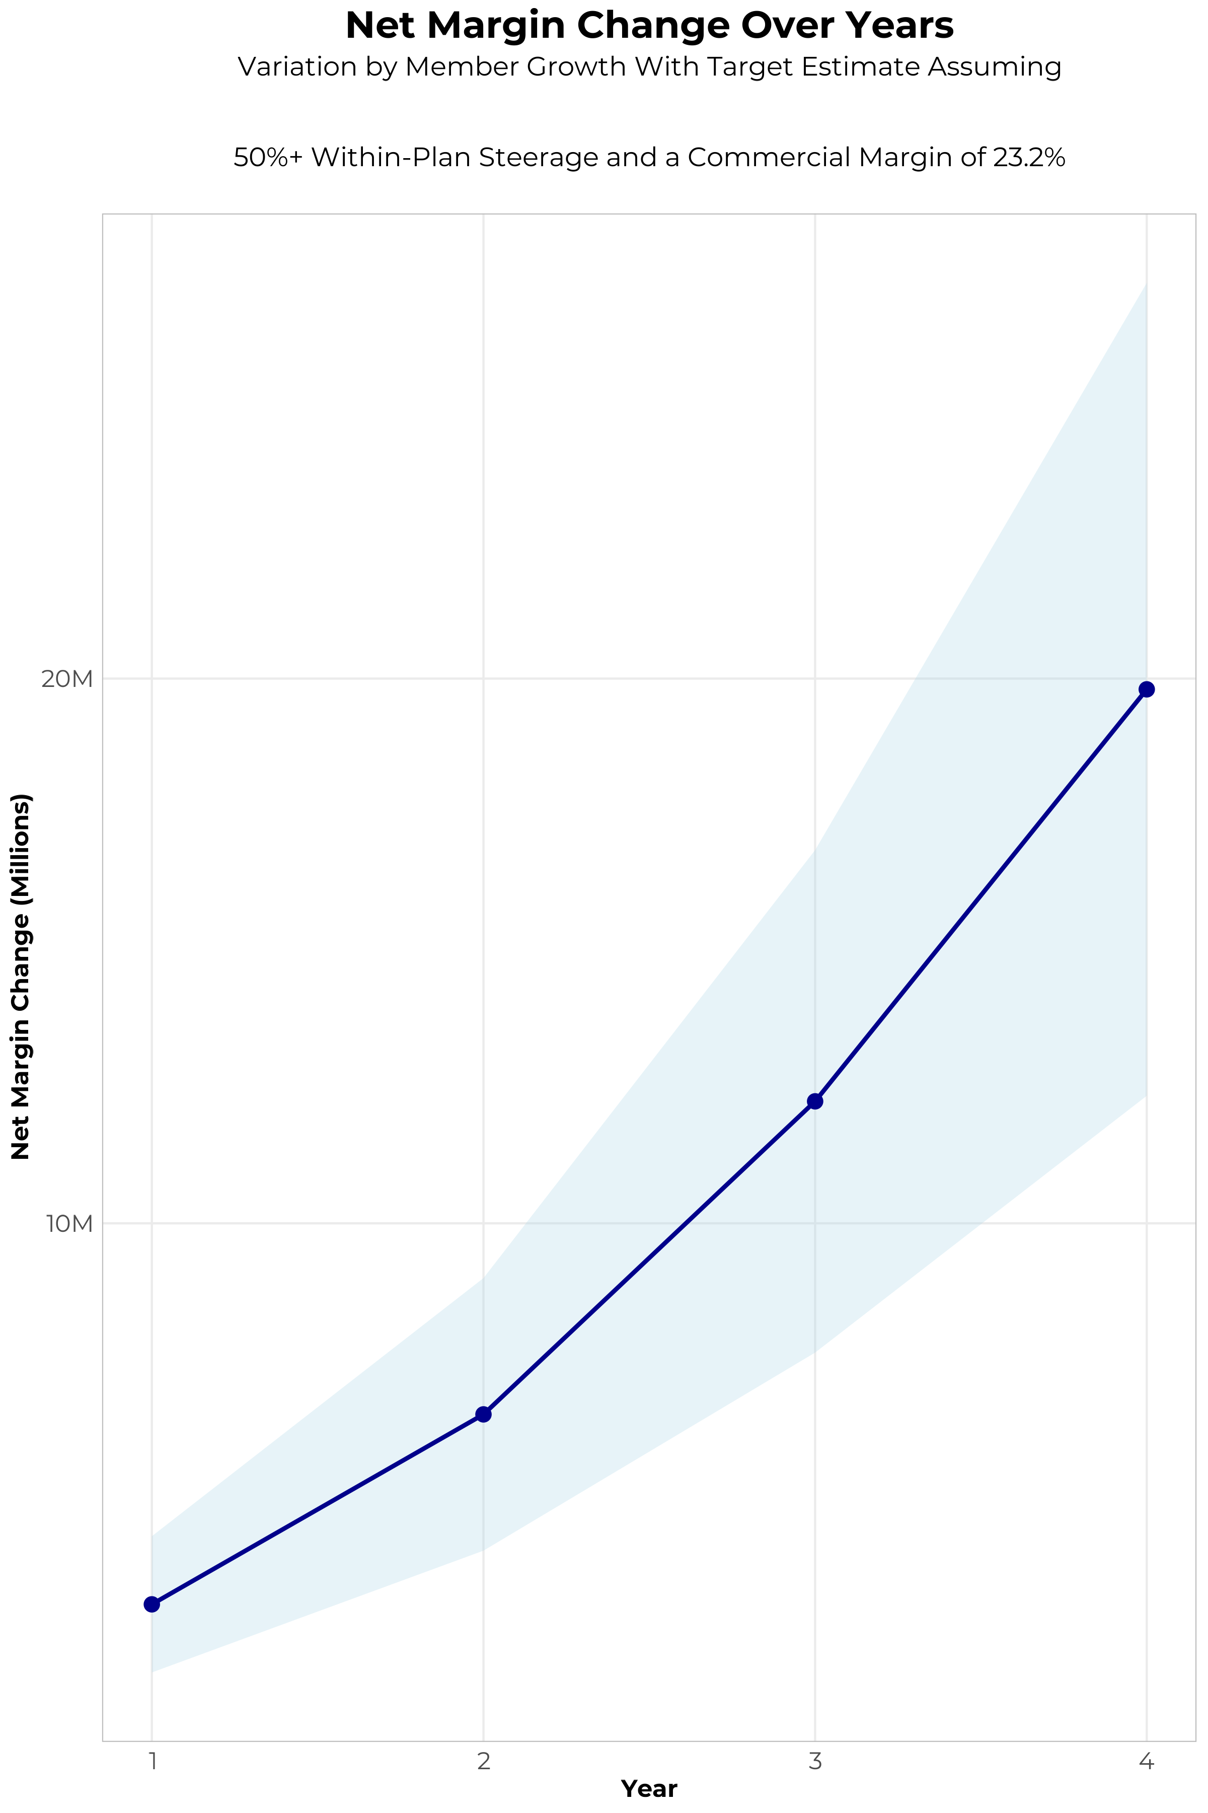
FOUR-YEAR PROJECTIONS
Target Member Growth | Target Member Growth | Target Member Growth | Target Member Growth | Target Member Growth
Metric | Year 1 | Year 2 | Year 3 | Year 4
Number of Members | 3,200 | 6,400 | 10,500 | 15,800
Incremental Margin | 3,296.3K | 6,595.3K | 12,293.1K | 19,793.2K
Network Access Fee | 38.4K | 76.8K | 126.0K | 189.6K
Implementation Fee (One-Time) | -150.0K | 0.0K | 0.0K | 0.0K
Sales and Marketing Costs | -180.0K | -180.0K | -180.0K | -180.0K
Net Margin Change | 3,004.7K | 6,492.1K | 12,239.1K | 19,802.8K
High Member Growth | High Member Growth | High Member Growth | High Member Growth | High Member Growth
Metric | Year 1 | Year 2 | Year 3 | Year 4
Number of Members | 4,400 | 8,800 | 14,400 | 21,700
Incremental Margin | 4,532.4K | 9,068.5K | 16,859.1K | 27,184.3K
Network Access Fee | 52.8K | 105.6K | 172.8K | 260.4K
Implementation Fee (One-Time) | -150.0K | 0.0K | 0.0K | 0.0K
Sales and Marketing Costs | -180.0K | -180.0K | -180.0K | -180.0K
Net Margin Change | 4,255.2K | 8,994.1K | 16,851.9K | 27,264.7K
Low Member Growth | Low Member Growth | Low Member Growth | Low Member Growth | Low Member Growth
Metric | Year 1 | Year 2 | Year 3 | Year 4
Number of Members | 2,000 | 4,000 | 6,600 | 9,900
Incremental Margin | 2,060.2K | 4,122.1K | 7,727.1K | 12,402.1K
Network Access Fee | 24.0K | 48.0K | 79.2K | 118.8K
Implementation Fee (One-Time) | -150.0K | 0.0K | 0.0K | 0.0K
Sales and Marketing Costs | -180.0K | -180.0K | -180.0K | -180.0K
Net Margin Change | 1,754.2K | 3,990.1K | 7,626.3K | 12,340.9K

Slide 8
YEAR 4 PROJECTED REVENUE AND PROFIT
Pre-DTE Cohort of 15,800 Employees | Inpatient | Outpatient | Professional | Total
Revenue† | $ 9,738,516 | $ 16,925,480 | $ 7,904,055 | $ 34,568,051
Net Income‡ | $ 2,259,336 | $ 3,926,711 | $ 1,833,741 | $ 8,019,788
† Assuming proportional revenues from market shares of 18% (inpatient) and 17% (outpatient)
‡ Conservatively assuming a commercial margin of 23.2% (80% of the estimated commercial margin)
With DTE | Inpatient | Outpatient | Professional | Total
Revenue⁰ | $ 36,078,632 | $ 56,569,949 | $ 26,417,685 | $ 119,066,267
Net Income* | $ 8,370,243 | $ 13,124,228 | $ 6,128,903 | $ 27,623,374
⁰ Assuming 67% inpatient and 58% market steerage based on KBA narrow network DTE experience (see previous slide)
* Conservatively assuming a commercial margin of 23.2%, with a 10 percentage-point reduction to reflect competitive-edge rates and a 10 percentage-point increase due to lower billing costs and higher patient responsibility collections because of the member credit card.
Total Increase in Net Income | $ 19,603,586
Network Access Fee (Revenue) of $1 PMPM | $ 189,600
Total Profit Growth | $ 19,608,386
Minus Implementation Fee (One-Time) | -$ 0
Minus Sales and Marketing (Annual – Ongoing) | -$ 180,000
Total | $ 19,613,186

Slide 9
Target Estimate Assuming 50%+ Within-Plan Steerage and a Commercial Margin of 23.2% | Target Estimate Assuming 50%+ Within-Plan Steerage and a Commercial Margin of 23.2% | Target Estimate Assuming 50%+ Within-Plan Steerage and a Commercial Margin of 23.2% | Target Estimate Assuming 50%+ Within-Plan Steerage and a Commercial Margin of 23.2% | Target Estimate Assuming 50%+ Within-Plan Steerage and a Commercial Margin of 23.2%
All values in thousands of dollars. Modeled With Year 1 Fees and Patient Steerage. | All values in thousands of dollars. Modeled With Year 1 Fees and Patient Steerage. | All values in thousands of dollars. Modeled With Year 1 Fees and Patient Steerage. | All values in thousands of dollars. Modeled With Year 1 Fees and Patient Steerage. | All values in thousands of dollars. Modeled With Year 1 Fees and Patient Steerage.
Metric | 500 DTE Covered Lives | 1000 DTE Covered Lives | 5000 DTE Covered Lives | 25000 DTE Covered Lives
Pre-DTE Group Inpatient Revenue | $308.2 | $616.4 | $3,081.8 | $15,409.0
Pre-DTE Group Inpatient Margin | $71.5 | $143.0 | $715.0 | $3,574.9
DTE Group Inpatient Revenue | $1,020.2 | $2,040.4 | $10,202.1 | $51,010.5
DTE Group Inpatient Margin | $236.7 | $473.4 | $2,366.9 | $11,834.4
DTE Group Incremental Inpatient Revenue | $712.0 | $1,424.1 | $7,120.3 | $35,601.5
DTE Group Incremental Inpatient Margin | $165.2 | $330.4 | $1,651.9 | $8,259.5
Pre-DTE Group Outpatient Revenue | $535.6 | $1,071.2 | $5,356.2 | $26,780.8
Pre-DTE Group Outpatient Margin | $124.3 | $248.5 | $1,242.6 | $6,213.2
DTE Group Outpatient Revenue | $1,545.9 | $3,091.9 | $15,459.3 | $77,296.4
DTE Group Outpatient Margin | $358.7 | $717.3 | $3,586.6 | $17,932.8
DTE Group Incremental Outpatient Revenue | $1,010.3 | $2,020.6 | $10,103.1 | $50,515.6
DTE Group Incremental Outpatient Margin | $234.4 | $468.8 | $2,343.9 | $11,719.6
Pre-DTE Group Professional Revenue | $250.1 | $500.3 | $2,501.3 | $12,506.4
Pre-DTE Group Professional Margin | $58.0 | $116.1 | $580.3 | $2,901.5
DTE Group Professional Revenue | $721.9 | $1,443.9 | $7,219.4 | $36,096.8
DTE Group Professional Margin | $167.5 | $335.0 | $1,674.9 | $8,374.4
DTE Group Incremental Professional Revenue | $471.8 | $943.6 | $4,718.1 | $23,590.3
DTE Group Incremental Professional Margin | $109.5 | $218.9 | $1,094.6 | $5,473.0
Net Margin Less DTE Fees | $185.0 | $700.1 | $4,820.4 | $25,422.1

Slide 10





A PARTNER YOU CAN TRUST
OUR OBJECTIVES ARE ALIGNED
WE KNOW THE
MARKET
COMPLETELY TRANSPARENT
WE HAVE THE SOPHISTICATION AND INFRASTRUCTURE TO EFFECTIVELY COMPETE
Derek Moore, Senior Vice President – KBA
845-283-9973 * derek.moore@keybenefit.com

